Slide 1
Linguistics 200, Week 3
Culture

Slide 2
Warm-up Questions: Episode #1 recap
Select the qualities of spoken language that makes a conlang feel “legit”.
A writing system with many different symbols
Having its own acoustic “brand”, a particular rhythm in speech
Having variable sentence lengths
Producing words that carry distinct meanings
The Tolkien estate’s seal of approval
What is Ubese? And why do many not consider it a conlang?
What is another language in media? Search for an example of a conlang we have not discussed and consider what is “good” or “bad” about it.

Slide 3
This Week
Monday:
Share your composition with your groupmates
Cultural features that may affect structure
Map
Wednesday:
Linguistic Bias
Friday:
Share your complete cultures with your groupmates
Finish any parts that need to be finished

Slide 4
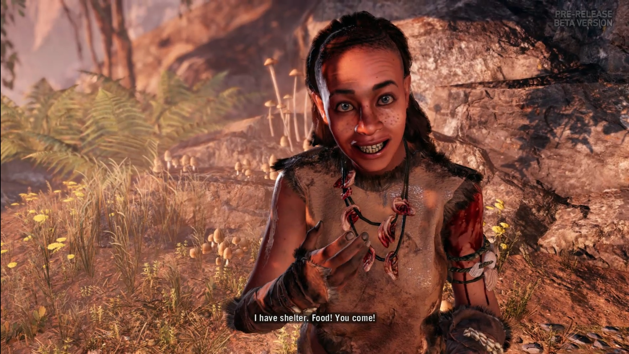
4. What kinds of structures are in place in your culture that could potentially affect how the language is structured? Considerations include, but are not limited to, the following:
Is your language exceptionally focused on politeness and proper titles (like, say Korean or Japanese)?
Is the culture structured towards family units?
Or is the culture primarily focused on civic duty and government loyalty?
Is your culture individualistic and even anarchic?
Is language something freely shared between different groups (such as those based in socio-economics, gender, nationality, etc.), or is a hierarchy strictly enforced?
You don't need to have everything nailed down, but pick three of the ideas above (you may discuss other areas of culture, as long as you do so thoughtfully) and expand on them. Please be careful in your cultural choices; offensive depictions of cultures (fictional or otherwise) will not be tolerated. Remember that you will be sharing your ideas with other classmates throughout the semester.

Slide 5
Why does this matter?
Example: English pronouns

Slide 6
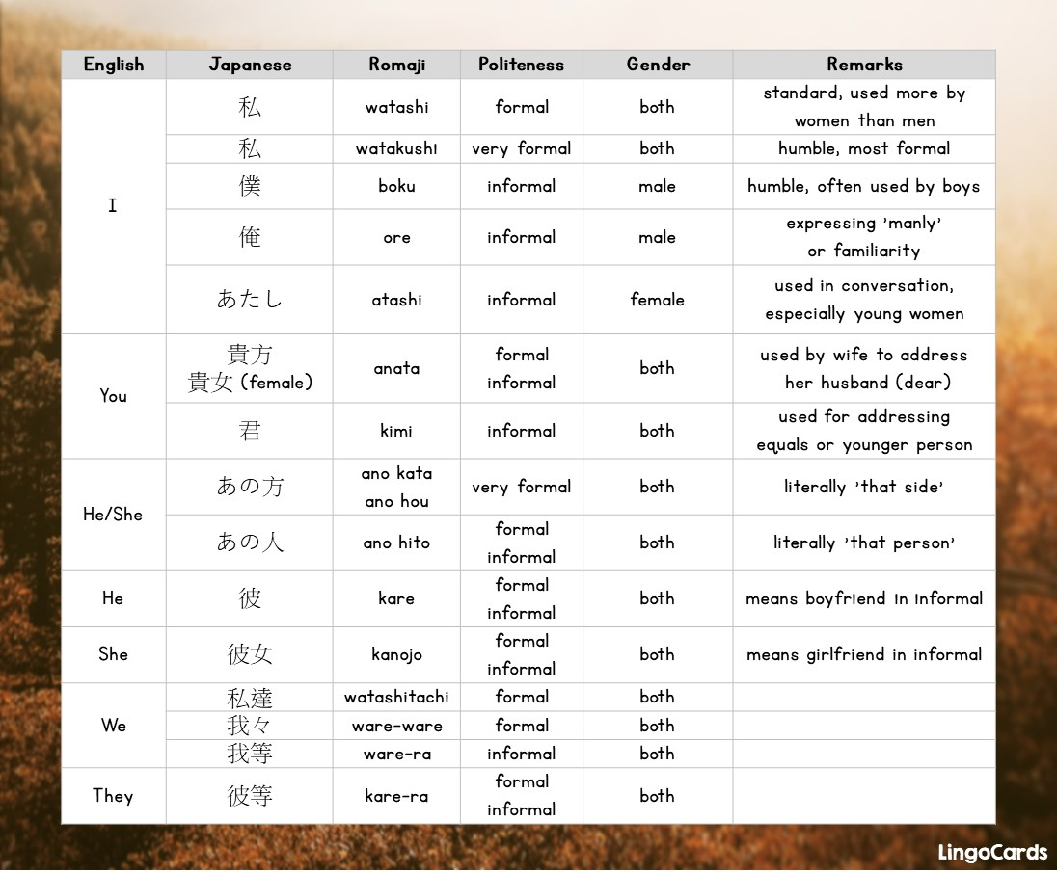
Why does this matter?
Example: Japanese pronouns

Slide 7

Why does this matter?
Example: Th'anthk pronouns

Slide 8
Why does this matter?
Example: gender
Indo-European
Note: grammar is not determinative!
Turkish & Chinese gender
Chinese & Hopi tense

Slide 9
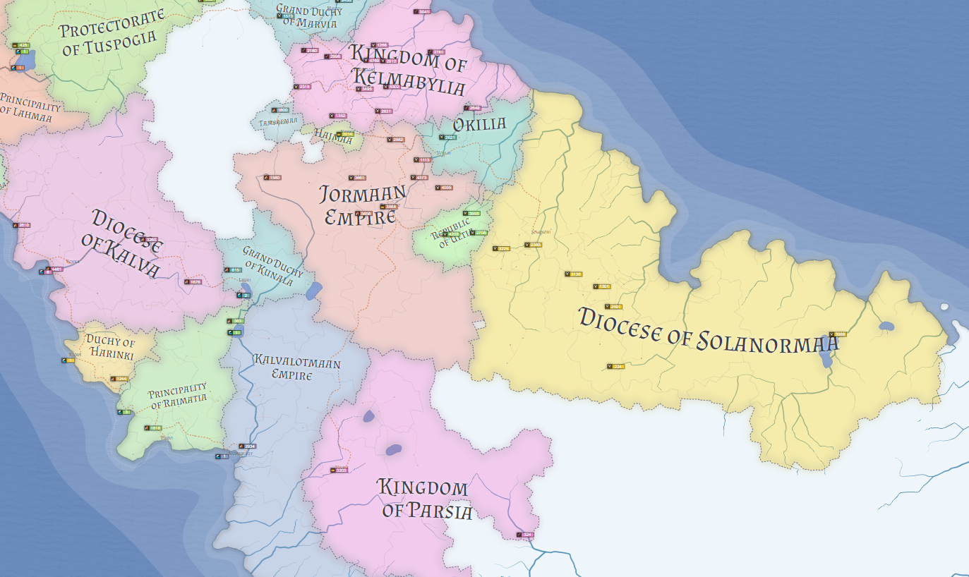

Slide 10
Possible places to generate maps
https://azgaar.github.io/Fantasy-Map-Generator/
https://inkarnate.com/signup
https://donjon.bin.sh/world/
https://www.kassoon.com/dnd/world-map/

Slide 11
Share Compositions!

Slide 12
Linguistics 200, Week 3
Linguistic Bias

Slide 13
With your neighbors: Episode #3 Recap
What does it mean to have a negative language ideology?
What influenced J.R.R. Tolkien in the creation of the languages of Middle Earth? What sorts of problems arise from these influences?
What’s one way the Drs. Byrd avoided enforcing negative stereotypes in their conlangs, Wenja & Izila?

Slide 14
What is linguistic bias?
Bias = a tendency for prejudice towards a person or certain groups of people
Can result in unfair treatment, such as exclusion or discrimination
Can be conscious or unconscious as well as positive or negative

Slide 15
What is linguistic bias?
Linguistic bias = all that, but about language!
Echos existing stereotypes that are held about particular groups of people
These are judgments embedded within a language that reflect stereotypes and often disfavor certain groups of people
What are some examples of linguistic bias?
Have you personally experienced any?

Slide 16
Linguistic bias
Every language evokes some sort of bias
With conlangs, we choose the bias that we evoke
Saying “like”
Saying “y’all”
Uptalk & Vocal Fry (High Rising Terminal, Creaky Voice)
What biases do you think people have about these?

Slide 17
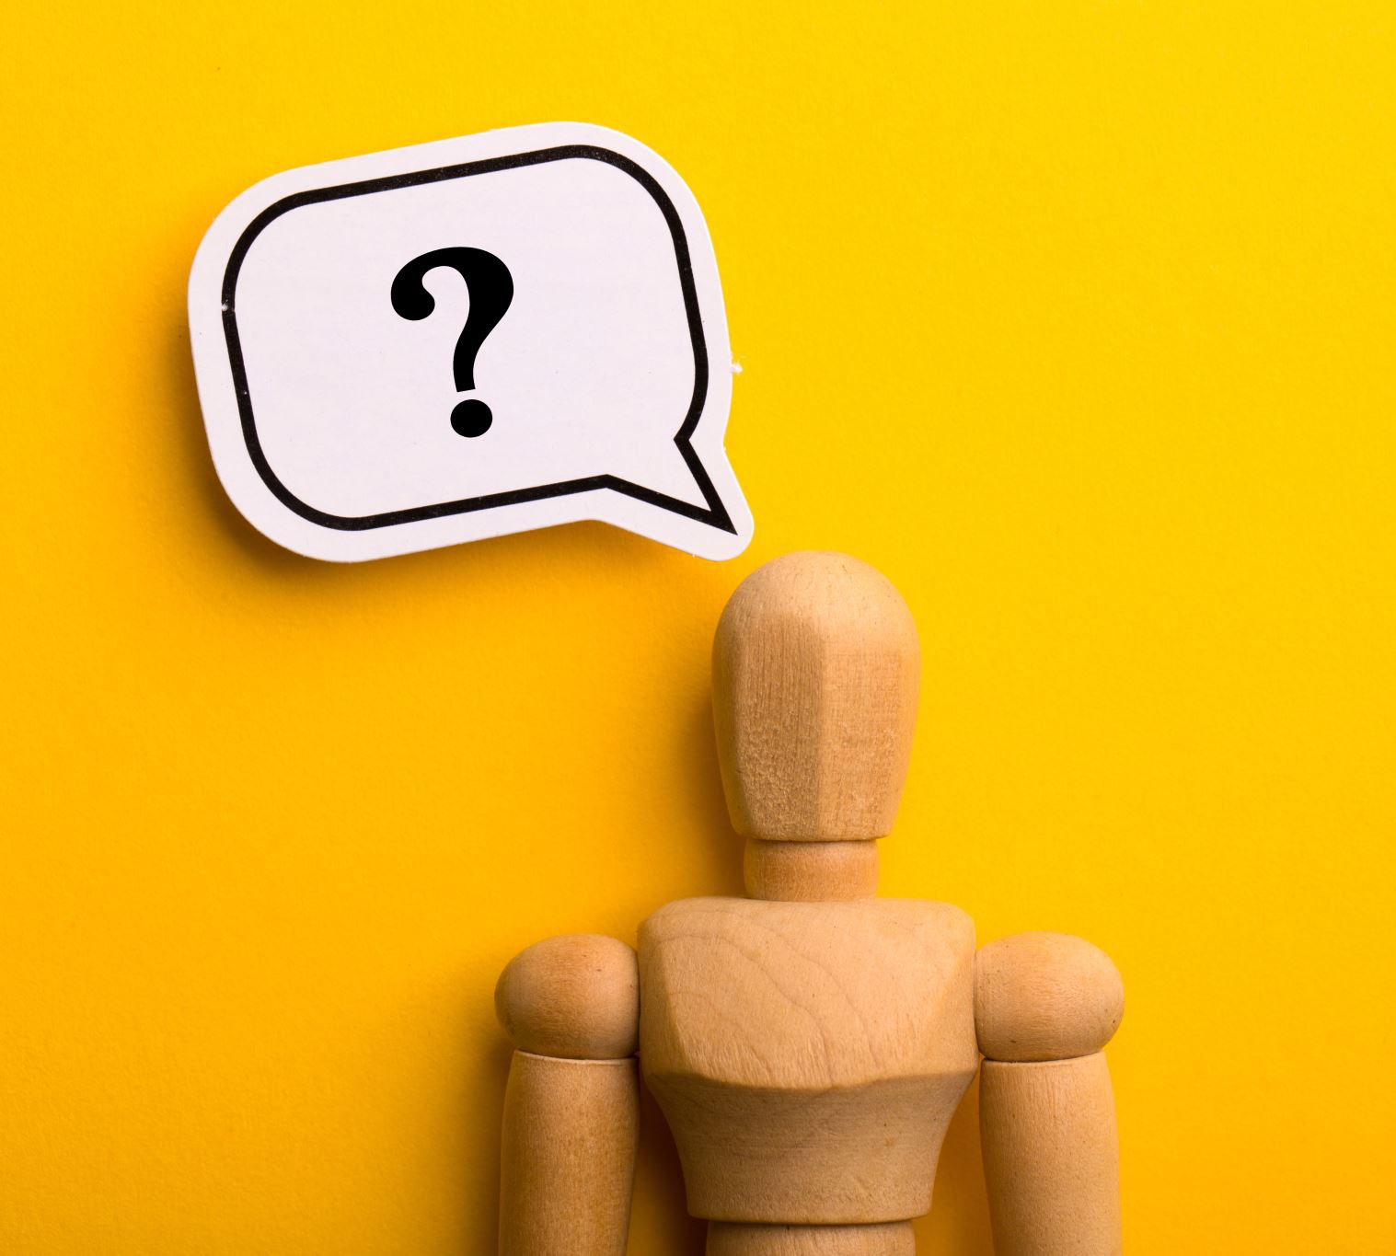
If every language evokes bias, what can we do?
Avoid pairing real-world cultural influences with linguistic influences
Avoid stereotypes
If you don’t know a culture, don’t make inferences
Ask “am I doing this because this makes sense for this culture, or because I’m tying it to my own experiences and biases?”

Slide 18
A recent example discussion
With your neighbors, read the following article and discuss: https://medium.com/@allisonooo/do-we-judge-languages-by-their-sounds-exploring-linguistic-bias-in-entertainment-13da8300ae83
What does the author point out about linguistic bias in conlangs?
Do you agree?
Notes:
https://medium.com/@allisonooo/a-conversation-with-david-j-peterson-d585a14589d1 interview with Peterson

Slide 19
Conlang Culture & Bias Discussions
Which groups did you draw inspiration from (knowingly or unknowingly)?
What sort of cultural biases might be in your culture?
How can you combat these biases in your language?
* See what biases you can spot, then see if your group spots different ones! *

Slide 20
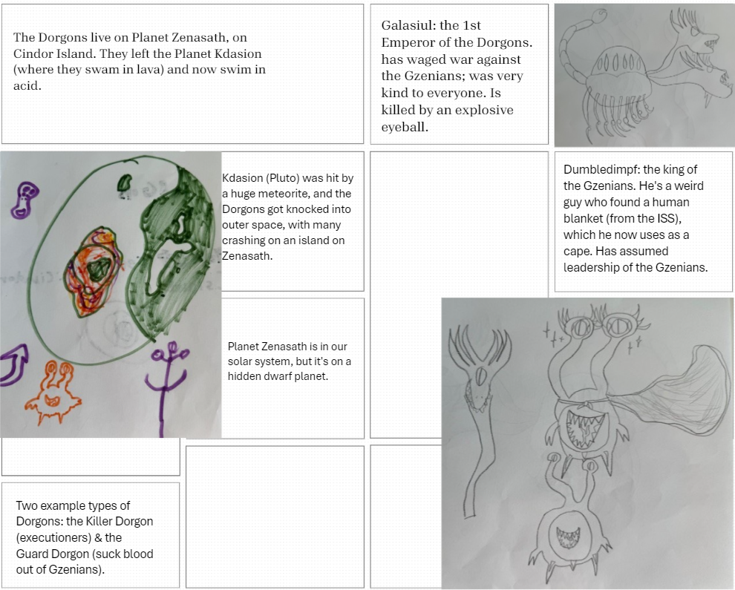
Conlang Culture & Bias: the Dorgons
Which groups did Elijah draw inspiration from (knowingly or unknowingly)?
What sort of cultural biases might be in his culture?
How can we combat these biases in his language?

Slide 21
Conlang Culture & Bias Discussions
Which groups did you draw inspiration from (knowingly or unknowingly)?
What sort of cultural biases might be in your culture?
How can you combat these biases in your language?
* See what biases you can spot, then see if your group spots different ones! *

Slide 22
5. What kinds of real-world cultures will you be drawing on to inspire or help guide the world of your conlang? As you mention these, you must discuss what sorts of biases to avoid in your language's creation.
For instance, let's say you were inventing an artlang for a group of people who lived in the rural mountains of the Eastern US, whose sound system bears a striking similarity to that of Southern American English. Moreover, the people who speak your conlang are unusually friendly and/or ignorant -- in this case negative biases would be affecting both your language and culture.

Slide 23
Linguistics 200, Week 3
Finishing up Component 1

Slide 24
Review of Bias
Bias = a tendency for prejudice towards a person or certain groups of people
Linguistic bias = all that, but about language
It occurs in real languages & conlangs
Linguistic bias will happen
Occurs in all aspects of language
We can control how our conlangs are biased
We can respect linguistic variety and cultural diversity

Slide 25
Turn & Talk
Have you experienced linguistic bias this week (or at any time)?
What are some ways you can avoid importing bias into your Culture/Conlang?

Slide 26
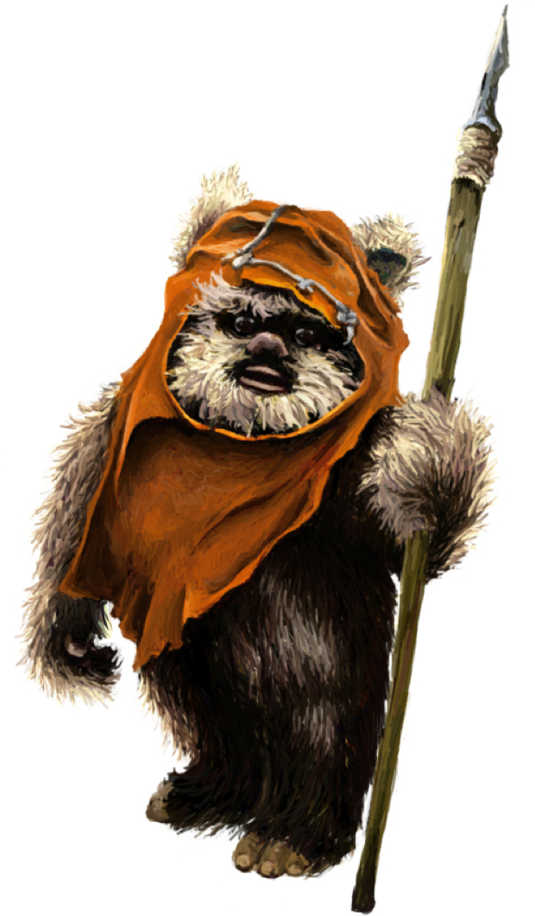
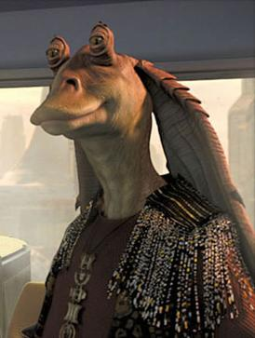

Don't Be Like...

Slide 27
Today
Finish up your component, consult with group members & Dr. Byrd if you need help
Component 1 due next Monday (9/16) at 10 am
Next week we'll be shifting gears, learning about more technical, "linguisticky" kind of stuff.
Watch Episodes 5, 6, and read pp. 25-46 of Peterson before Monday.

